Slide 1


Successfully Preparing Daily For Your MOR
North Tampa Housing Development Corporation
April 19, 2023
Notes:
Welcome

Slide 2
Introductions
Presenters today…
Rebecca Kuntz
Local Service Manager
Karen Wherry
Local Contract Specialist
(Tampa)

Slide 3
North Tampa Housing Development corporation
Today’s Agenda
Suggestions to prepare for your next MOR
Discuss items listed on the Addendum C
Ways your property can always be ready for an MOR
Review Best Practices

Slide 4

North Tampa Housing Development corporation
Preparing for your next
MOR

Slide 5
North Tampa Housing Development Corporation
Resources to Consider
MOR Form HUD 9834
Download and print a copy of the form
Read through the form so you know what will be reviewed
Use the form as a guide when you are doing a self-audit of the property
Make sure on-site staff review/learn the form so they are also aware of what will be reviewed
RHIIP Listserv
    Once registered you will receive emails on upcoming changes as well as current issues. You can sign up for the RHIIP Listserv at: http://www.hud.gov/subscribe/mailinglist.cfm

Slide 6
Be Proactive…..
Preparation for an MOR should be ongoing, not just limited to the days and weeks prior to your scheduled MOR.
MORs are scheduled at least 14 days in advance.
A written confirmation will be sent out along with the Addendum C prior to the on-site review date.
Take time once an MOR has been scheduled to review the property and all required documents.
Review that all new procedures have been implemented, and regulations are being followed. Take any necessary corrective actions prior to the on-site review.
Obtain requested documents and have them available for the reviewers.

Slide 7
North Tampa Housing Development Corporation
Be Proactive…..
      Review staff practices for compliance with current and NEW regulations and procedures.
      Provide all needed training/instruction to staff to correct any deficiencies in staff practices.
    Review the physical condition of the site as well as the last REAC inspection.
      Make all necessary repairs.
    Review last MOR to ensure all corrective actions have been completed/implemented.
      Ensure all 100% file reviews that were required have been completed and necessary corrections made.
      Correct any repeat/recurring deficiencies.

Slide 8
North Tampa Housing Development corporation
On the day of the MOR,
Be Present And Be Ready!
Be on-site during the MOR
Have all requested documents ready and available for review at the start of the MOR
Pull files and additional documents as requested
Obtaining documents/information from the home/corporate office if needed
Be available and be prepared to answer any questions
Participate in the questionnaire interview and be prepared to discuss or explain any item as needed
Be present and participate in the close out meeting where the reviewer will discuss all preliminary results

Slide 9

North Tampa Housing Development Corporation
Overview of the Addendum C Documents

Slide 10
What is the Addendum C?
  This is sent with your schedule letters and gives you a list of information and documents you must have available and ready on the morning the MOR starts.

Slide 11

North Tampa Housing Development Corporation
1st Item on List …..
All Tenant Files and Records, including….
    Rejected applicants
    Move Ins files
    Move out files

Slide 12

North Tampa housing development corporation
Tenant Files
Make sure to file everything
Do your own internal pre-audit before the MOR
Have files organized, and in date order, so the reviewer can easily determine if the required information is there
Remember to provide any applicable archive files for selected tenants

Slide 13

Current Waiting List
  It must contain ALL of the following information:
    Head of Household Name
    Date/time of receipt of application (or pre-application if one is used)
    Annual Income Level (Low, Very Low, ELI)
    Need for accessible unit or features
    Preference Status (if there are preferences on the property)
    Unit Size

Slide 14
Current Waiting List
What do we want to see during the MOR?
An auditable waiting list:
  Separated by bedroom size
  Sorted by application date and time (not alphabetically)
  Includes all required information for each applicant (don’t leave columns blank)
  Include all pass over notes and other dated comments to show a complete history of ALL actions taken for all applicants (Show: actives, rejections, removals, move ins, skips, notes, make sure every action/comment is dated)
  Have the total number of active people for each bedroom size easy to find
  Do NOT rely on “memory” about actions taken with any applicants. The waiting list should be able to tell it’s own story without any commentary from staff. WRITE IT ALL DOWN!
  Work your waiting list to ensure that overall vacancy lengths are minimal.

Slide 15
North Tampa Housing Development corporation
Current Waiting List
  Make sure staff (or you) know how to use the software and can print an auditable waiting list.
  It should show all applicants including removed/rejected, Move In/s and Active applicants
  If the printed file is too large (more than 20-30 pages), ask your Reviewer if they are willing to review an electronic copy instead.

Slide 16

North Tampa Housing Development corporation
Current Waiting List
Is it ok if I don’t keep all the notes on the waiting list itself?
(For example: I keep notes on each individual applications but don’t always take the time to transfer them to the waiting list.)

Slide 17

North Tampa Housing Development corporation
NO…
The waiting list should serve as a stand-alone document to show an auditable trail of all actions and contact with each applicant to make it easy to identify that applicants were moved in using the proper order or skipped for valid reasons when needed.

Slide 18
North Tampa Housing Development corporation
Last Advertisement and/or copies of brochures
What do we want to see during a MOR?
  Provide a copy of all advertising and marketing done in the last 12 months including copies of adds, brochures, flyers, and documentation of contact with the Community Contacts listed in the AFHMP
  Make sure the fair housing logo/statement are on ALL advertisements and brochures
  If a phone number is listed, make sure a TTY (or equivalent system) is also listed

Slide 19
North Tampa Housing Development corporation
HUD-approved Rent Schedule form HUD-92458
  Make sure the current rent schedule has been executed in accordance with HUD regulations
  Post the current Rent Schedule in a visible place for tenants to see.
  Update Software
  Correct any certs processed ahead of time for upcoming AR’s due, but before rents were effective.
  If you have any rented commercial space, make sure it is listed on the rent schedule

Slide 20
North Tampa Housing Development corporation
Work order Journals and Logs
BEFORE the MOR: Run a work order history report and see which ones are open for more than a couple of days; Complete and close open work orders before the MOR
Make sure you can easily determine the date the work order was initiated, and the date it was closed, along with a description of work performed
On a daily basis, the work order completion rate needs to be part of your checklist at the end of the day.
During the MOR, provide documentation and information on all open, and closed, work orders for the last 12 months as we will be reviewing the length of time to complete.

Slide 21
North Tampa Housing Development corporation
Copies of the form HUD-52670 (your monthly vouchers)
For the last twelve months, for each subsidy contract
  If the Reviewer has the capability to review vouchers electronically then hard copies are not necessarily needed
  Review your final vouchers each month and compare them to your rent roll to find possible errors
Rent Roll
  Make sure it is current
  Make sure rent and fees are being collected, and tenants listed with large balances owed, can be explained
  Here you can review any TTP that is less than $25 and make any necessary corrections if the hardship does not apply
  Every month, compare this to your monthly vouchers

Slide 22
North Tampa Housing Development corporation
Application
  Provide copies of pre-application (if you use one)
  Copies of full application packets, including all attachments (make sure they are all the most recent versions and have the most up-to-date information)
  Make sure the versions at corporate headquarters are the same being used at the property
  Make sure your application contains all required information (Per HUD Handbook 4350.3 Chapter 4, 4-14 B)
  Make sure application has fair housing logo/statement and a TTY (or equivalent system) if a phone number is listed
  Applications need to be signed/dated by applicants
  Application needs to be on file for each adult household members
  Make sure you have procedures in place to:
    Date/time stamp when received
    Review for full completion (make sure applicant left no blanks)
    Verify all information listed
    Get updated information if too much time has passed between application submission, when they reach the top of the waiting list, and at move in

Slide 23
North Tampa Housing Development corporation
HUD-9887/9887A Form
Reminder:
NTHDC has a new address as of 05/01/2020. Remember to update
the appropriate box in the 9887 forms in all places/packets it is
used, and any other relevant documents. Also, ensure the HUD office and Owner information is correct.
The new address is:
4300 West Cypress Street, Suite 300,Tampa, FL 33607

Slide 24
North Tampa Housing Development corporation
Application
Is it ok for me to use a partially filled out application
to add someone to the waiting list as long as I have them fill out any missing information before their move in date?

Slide 25
North Tampa Housing Development corporation
Answer:
No. All information must be filled out on the application because this is used to determine eligibility prior to being added to the waiting list.

Slide 26

North Tampa Housing Development corporation
  HUD Model Lease
  Have the right version of the lease for your program type (determined by your HAP contract; refer to HUD 4350.3 Figure 6-2).
  Make sure initial, AND renewal lease terms are correct for your program type (refer to HUD 4350.3 Figure 6-3)
  Ensure all blanks in the lease are filled out correctly and have any back up documentation for any fees/charges (fees, charges, interest rate on security deposit, security deposit amount, etc.; refer to 4350.3 Appendix 4-E and 4-F)
  Ensure ALL Adult household members are listed in Paragraph 1 (not just head of household)
  Make sure all leases are signed/dated by ALL adult household members

Slide 27
North Tampa Housing Development corporation
Lease Addendum
  HUD Required: VAWA Lease Addendum (HUD-91067)
    Correct effective date
    Information filled out completely at top
    All adult household members sign/date
  Owner Adopted Addenda
    Must have written HUD approval for each one for the specific property
    If you have “Agreements” that have language changing information in the lease these are considered lease addendums and need HUD approval also

Slide 28

North Tampa Housing Development corporation
Pet Lease Addendum
(not the same as Pet Rules/Policy)
    Required at properties serving elderly/disabled population, but are not using the 202/8 model lease (HUD – 90105B)
    Requires written HUD approval; Have it available during the MOR for the specific property
    Must contain the language that is in the 202/8 model lease regarding pet ownership
    Must be given to ALL tenants whether they own a pet or not

Slide 29
North Tampa Housing Development corporation
  Pet Rules/Policy
    Not the same as the Pet Lease Addendum
    Does not require HUD approval
    Required to have specific information in them, per HUD Handbook 4350.3 Chapter 6, 6-10 and Exhibit 6-5
    Properties serving an elderly and/or disabled populations are required to have this.
    Cannot be applied to assistance animals
    Must be given to ALL tenants whether they own a pet or not (HUD 4350.3 Chapter 6, 6-10.B.3.)

Slide 30
North Tampa Housing Development corporation
House Rules
  Do not need HUD approval, but must be reasonable and in line with Section 8 guidelines.
  Date the House Rules so it is easy to determine which version you are using.
  All tenants need to be on the most recent version at the same time
  All Adult members must sign/date them.
  If fees or charges are listed, either have written HUD approval, or documentation showing actual cost, and have it ready at the MOR.
  VAWA procedures must be addressed in House Rules and if there are other sections effected by VAWA regulations they need to be updated as well (for example if there is a section on unit transfers, make sure it is updated)
  Make sure they do not contain outdated information (Like HUD-91066 which is obsolete and was replaced with HUD-5382).
  Live in Aides can be evicted for violating them so have procedures in place to show Live in Aides received a copy and are aware of what they are

Slide 31
North Tampa Housing Development corporation
If House Rules are updated, is it ok to wait until each tenant’s Annual Recertification to give them the updated version?

Slide 32
North Tampa Housing Development corporation
No…
This leads to a situation where different tenants are held accountable for different rules on the property which can easily drift into fair housing violations. If House Rules are updated, send a 30-day notice to all tenants at the same time, and update the House Rules with all tenants at the same time.

Slide 33
North Tampa Housing Development corporation
Pet Lease Addendum
  Pet Rules/Policy
House Rules

Slide 34
North Tampa Housing Development corporation
Application Rejection Letter/Removal Letter
  Must be in writing
  Must contain specific reason for rejection
  Must be consistent with information outlined in the property’s Tenant Selection Plan.
  Must contain reasonable accommodation language (i.e. it must state that “Persons with disabilities have the right to request reasonable accommodations to participate in the informal hearing process.”)
  Must contain appeal language and 14 day timeline (i.e. “The applicant has a right to respond to the owner in writing or request a meeting within 14 days to dispute the rejection.”)
  TTY (or equivalent system) if a phone number is listed
  Must attach HUD 5380/5382 (VAWA Notice of Occupancy Rights and VAWA Certification Form)
  Update your waiting list with rejection information
  Must include the Fair Housing Logo

Slide 35
North Tampa Housing Development corporation
Application Rejection Letter/Removal Letter
  Do you still need to send a formal letter if an applicant requests to be removed?
  What if an applicant did not respond to an update letter?

Slide 36
North Tampa Housing Development corporation
Application Rejection Letter/Removal Letter
  Yes. To both
  A formal letter still needs to be sent, the waiting list updated, and a copy kept for 3 years.

Slide 37
North Tampa Housing Development corporation
Annual Unit Inspections
  Ensure they are being done for all units and documented
  If not maintained in the tenant file, ensure you pull them for tenant files selected for review during the MOR and give them to the reviewer
  Make sure they are filled out and dated
  There is no specific format required by HUD for these but they need to be completed at least annually.
  If due to COVID-19, unit inspections were completed via remote or virtual, make sure to have documentation ready for the reviewer

Slide 38
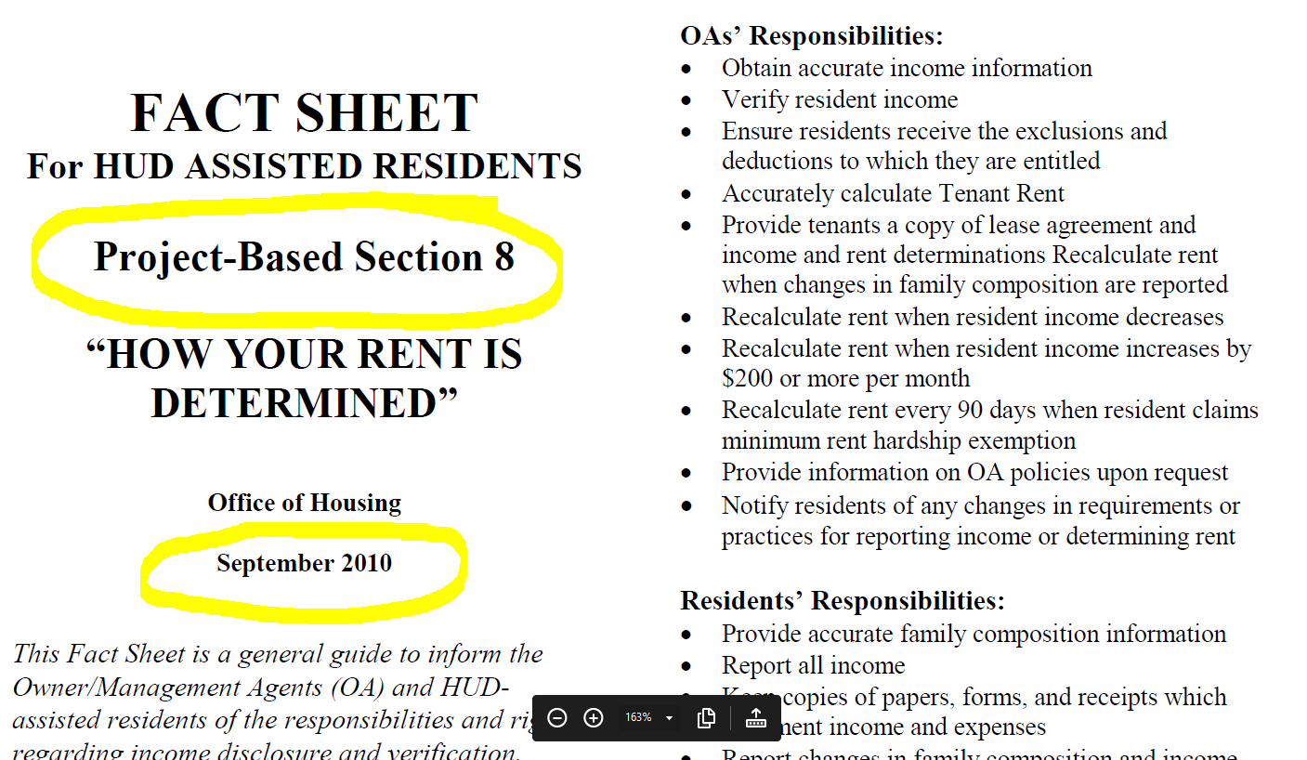

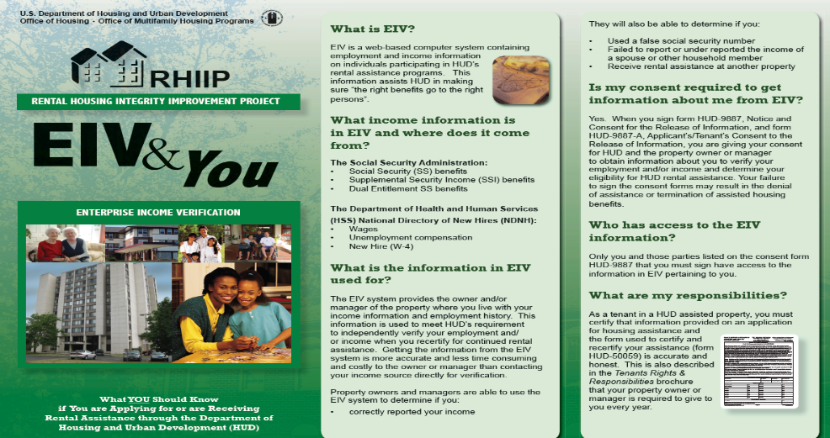
North Tampa Housing Development corporation
  Ensure you have the most up-to-date version of all forms
  Make sure acknowledgements are signed/dated in the file for Move in, and each AR

Slide 39
North Tampa Housing Development corporation
Lead Based Paint Certifications
(Applies to properties built prior to January 1, 1978)
  What do we want to see during an MOR?
  Have copies of any inspections, reports, and certifications available
  Any inspections must be conducted by certified inspector and must be done to meet HUD identified standards for lead
  Documentation of being lead free must be provided during each MOR, even if you have provided it at a previous one
  If your property has been certified as “lead free” you do not have to provide the Lead Paint Disclosure form to tenants, but need to have copies of information in office to provide upon request
  If your property has NOT been certified as “lead free” you must provide documentation of ALL of the following:
    Copies of inspections and reports
    Lead Hazard Control Plan (LHCP)
    Documentation of on-going maintenance and interim controls, in accordance with the LHCP
    Documentation that a visual assessment of all affected areas is being done at least annually AND at every unit turnover by property staff
    Documentation of re-inspection by certified inspector every 2 years, as needed

Slide 40
North Tampa Housing Development corporation
  Lead Based Paint Certifications
  (Applies to properties built prior to January 1, 1978)
NOTE: There are scenarios where every 2 years is not required
  If you have two inspections in a row with no hazards identified (but visual inspections are still required).
  If the Lead Hazard Control Plan states something different (i.e. If it states “every 2 years, or every 2 years until 2 consecutive without hazards found”, AND you are following it and maintaining the documentation)

Slide 41
North Tampa Housing Development corporation
All Operating Procedure Manuals
  Written procedures for:
    Conducting unit inspections
    Completing work orders
    Calculating income
    Processing different types of certifications
    Conducting Verifications
    Preventive Maintenance procedures and checklist
    Application procedures
    etc.….
Exigent Health and Safety (EH&S) Certifications
  Have copies of certifications sent to HUD for EH&S items
  Be prepared to have them inspected by Reviewer on a walk through if the REAC inspection is within 12 months of the MOR
  Have ALL EH&S items corrected within 72 hours of REAC inspection date, regardless of when the MOR is
  If you notice a repeat item (like missing or inoperable smoke detectors), add this item to your walk through list to be checked anytime staff is in the unit for things like unit inspections or maintenance items (changing AC filters, work orders, etc.)
  Also, we do a sampling of Non-EH&S REAC items as well, if most recent REAC is within 12 months prior to the MOR, so it is good practice to make sure all items on the REAC inspection have been corrected prior to the MOR

Slide 42
North Tampa Housing Development corporation
Documentation for Elderly Preferences
Under Sections 651 and 658
  This applies to elderly and elderly/disabled properties who have implemented the elderly preference requirements or implemented an elderly restriction
  If it applies to you, have the documents available during the MOR
  Your program type will dictate which part applies, if needed
Income Targeting and Tracking Log
  Pull Income Targeting for TWO timeframes
    Last complete FISCAL (not calendar) year
    Current FISCAL year
    Your fiscal year is determined by HUD and is different for each property
    Must show you met the 40% target last fiscal year and Reviewers want to see you are on target to meet it during the current fiscal year

Slide 43
North Tampa Housing Development corporation
EIV Information for Staff
  EIV Coordinators:
  Provide Owner’s letter of approval (*If the owner is also the EIV Coordinator….write yourself a letter giving yourself permission to be EIV Coordinator)
  Initial CAAF (the full document) signed by HUD Helpdesk
  Current CAAF printed from EIV system
  Copy of Cyber-Awareness Training Certificate dated within the last 12 months; must be repeated annually
    Note: If initial HUD approved/signed CAAF is missing you must request a copy from the EIV helpdesk or request a Replacement CAAF
    EIV User:
    Initial UAAF (the full document) signed by EIV Coordinator on the last page
    Current UAAF printed from EIV system
    Copy of Cyber-Awareness Training Certificate dated within the last 12 months; must be repeated annually

Slide 44
North Tampa Housing Development corporation
EIV Information for Staff
  Staff who need access to the EIV reports, but not necessarily the EIV system itself:
    EIV Rules of Behavior signed/dated (these only need to be signed once)
    Copy of Cyber-Awareness Training Certificate dated within the last 12 months; must be repeated annually
  Note: Make sure staff who no longer need access have been “unassigned” timely and not allowed to just passively “expire”

Slide 45
North Tampa Housing Development corporation
Staff who have access to TRACS
  Copy of TRACS Rules of Behavior, dated within the last 12 months (remember this is different from the EIV Rules of Behavior)
  Copy of Cyber-Awareness Training Certificate dated within the last 12 months; must be repeated annually; if staff was hired within the last 12 months this training must be dated within 30 days of signing the TRACS Rules of Behavior form

Slide 46
North Tampa Housing Development corporation
EIV Policies and Procedures
  It must contain ALL required information that HUD has outlined (see Chapters 7, 9, and Exhibit 9-5 in 4350.3), including use of EIV data and reports, maintaining security of EIV Data, and reporting breaches to the HUD Helpdesk, and collecting 9887/9887A when members turn 18 between annual recertification
  Make sure narrative section matches any timeframes listed in charts that may be in other sections of the P&P
  Make sure timeframes outlined are in accordance with HUD Policy

Slide 47
North Tampa Housing Development corporation
EIV Master Files
  Organize and label them for easy review of the information
  Make sure notes are sufficient for all tenants listed on each report
    Example: “reported/see tenant file/see last months report” is not a sufficient note if a tenant is listed on the New Hire report; you need more information (did they report timely, was it already included in AR income, was an IR needed, was a repayment agreement needed)
  Make sure they are being run in accordance with EIV Policies and Procedures and maintained according to HUD guidelines
  Do NOT maintain ANY tenant detail reports in the Master File
  Only Summaries of master reports go in the Master File
  Tenant detail reports belong in the tenant file along with any copies of documents, verifications, resulting certifications, repayment agreements, etc.

Slide 48
North Tampa Housing Development corporation
EIV Master Files
  Is it acceptable to run reports more frequently than what is listed in my company EIV P&P as long as I don’t run them less frequently than what is listed?

Slide 49
EIV Master Files
NO…
Reports frequency should match the EIV P&P
Notes:
Onsite practices MUST match what is outlined in the EIV P&P. HUD identifies minimum frequencies for some reports but if your property choses to run them more frequently, then the EIV P&P must be updated to reflect the onsite practices.

Slide 50
North Tampa Housing Development corporation
“Other” Items
  List of all security incidents/police calls/arrests for past 12 months and documentation of follow up with tenants involved or whose guests are involved
  It is also helpful to have a summary of the number of incidents occurring on the property grouped by categories (especially if you have a daily security log that has a narrative each day), such as:
    Break-ins (vehicle and residential), Vandalism, Auto Theft, Personal Assaults, Arrests, Drug Activity, Trespassing, Child Abuse/Neglect, General Disturbance, Domestic Disturbance, Sex offenses, etc.
  List of all vacancies for the past 12 months including:
    Move-out date
    Date ready for occupancy
    Move-in date for each vacated unit
    Average number of days from move-out to ready date AND move out to move-in
    Also all vacant unit preparation logs for the past 12 months
    Average from Move out to Move in needs to be 30 days or less

Slide 51
North Tampa Housing Development corporation
“Other” Items
  Inventory listing for tools, supplies and keys
  Appliances log with model and serial number by unit number, including date of purchase
  List of all employees including hire dates, title, annual salaries; and, if they live on site, bedroom size and whether or not they receive subsidy or are in a non-revenue producing unit
  Utility reimbursement log/documentation that checks are distributed within 5 business days from date the HAP money was received including date checks are available on-site, and date checks were distributed

Slide 52
North Tampa Housing Development corporation
“Other” Items
  VAWA documents:
    Form HUD-5380 Notice of Occupancy Rights under VAWA
    Form HUD-5382 Certification Form
    Form HUD-5383 Emergency Transfer Request Form
    Emergency Transfer PLAN (can use HUD-5381 as a guide)
    If you use the HUD Model Plan (HUD-5381) it MUST be modified to include certain information that is required, but was not covered sufficiently (or at all) by the Model Plan released by HUD
    Make sure you have filled out each area that required information about the specific property and/or owner
    Attach a list of LOCAL agencies relevant to VAWA situations

Slide 53
North Tampa Housing Development corporation
“Other” Items
  Copy of Termination of Tenancy letters, and Pay or Vacate Notices:
  MUST include the following (HUD 4350.3 Ch. 8, 8-13.B.2&3):
  Reasonable accommodation verbiage (“Persons with disabilities have the right to request reasonable accommodations to participate in the informal hearing process.”)
  10 days to discuss
  Date of termination
  Reason with detail, and…
  State that remaining in unit after date may result in court action
  Served on tenant by first class mail AND in person or under door
  VAWA Certification form and Notice of Occupancy Rights (HUD 5380/5382) attached to 1st notice for terminations
  Copy of Termination of Assistance letters
  Should include the following (HUD 4350.3 Ch. 8, 8-6.A.3):
    Date assistance will end
    Reason
    Amount rent will increase to
    State if increased rent not paid will terminate tenancy
    10 days to request meeting to discuss
    VAWA Certification form and Notice of Occupancy Rights (HUD 5380/5382) attached to 1st notice for terminations
    Reasonable accommodation language is encouraged

Slide 54
North Tampa Housing Development corporation
“Other” Items
  List of all evictions in the last 12 months and the reason for eviction
  Termination files within the last 12 month may be reviewed
  Grievance procedures for tenants, including appeal information (both for standard grievances and fair housing violations)
  List of Fair Housing Complaints, if any
  Written procedures for resolving tenant complaints or concerns

Slide 55
What do we look for during an MOR in an area that is easily accessible to the tenants?
Current Rent Schedule
Current AFHMP
Items to Display
Current Section 8 Income Limits
for the property
Tenant Selection Plan
Emergency contact numbers
Rent Collection Policy
**This is NOT an all inclusive list of things that can be displayed**

Slide 56
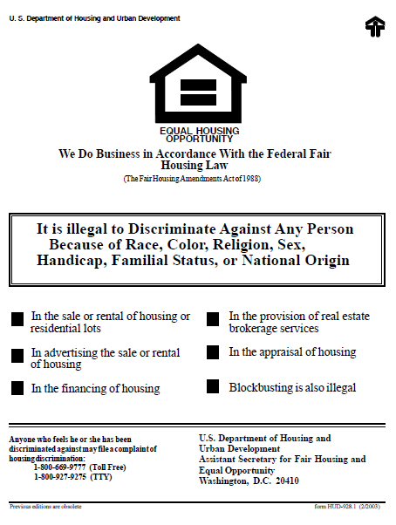
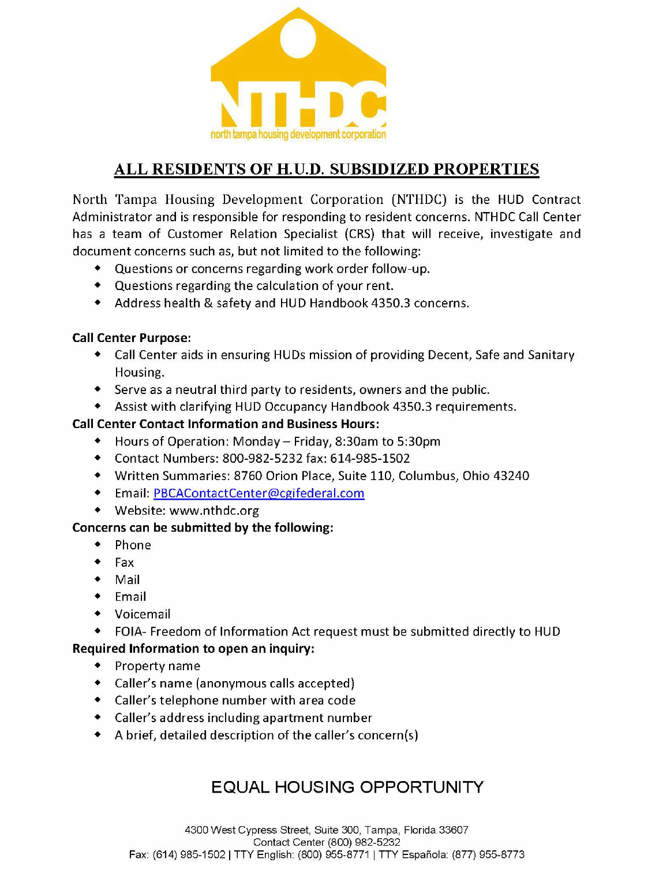
North Tampa Housing Development corporation
Other Items to Display
Fair Housing logo and Fair Housing Poster
NTHDC Call Center Form
  *Must be posted in the rental office or somewhere easily visible to tenants and potential tenants

Slide 57
North Tampa Housing Development corporation
“Other” items

Slide 58
North Tampa Housing Development Corporation
  Affirmative Fair Housing Marketing Plan
    The last HUD / FHEO approved AFHMP must be on site
    If plan has been updated, have a copy of the updated plan on file and documentation it has been submitted to HUD for approval
    The worksheets must be attached to the copy provided
    If a source has been replaced, make sure there is documentation with the plan to show the reason why.
    If the plan has been reviewed in the last 5 years, have documentation of the date it was reviewed, what was reviewed, and the review results.
    Have documentation of advertising in ALL sources listed in plan, along with community contacts (unless waiting list is closed or advertising was not required in the last 12 months).
    REMINDER: If you advertise in one source, you have to advertise in all sources listed in the AHFMP

Slide 59
North Tampa Housing Development corporation
  Affirmative Fair Housing Marketing Plan
A new AFHMP is not required for these situations:
If advertising sources listed go out of business, O/A just needs to document that the source is out of business and replace it with a source that will reach the targeted demographic.
If advertising source listed change names, O/A just needs to document the name change.
O/A still needs to advertise in all sources listed in on the AFHMP when they advertise even if sources target different demographics and O/A thinks they have enough applicants from one demographic but not the other.
A new plan is not required for a change in ownership or management as long as the new O/A agrees to follow the current, approved plan.

Slide 60
North Tampa Housing Development corporation
Tenant Selection Plan
MUST Include ALL required topics and accurately describe them from all of the following sources:
  HUD Handbook 4350.3
    Chapter 4, 4-4 C. (Contents of TSP)
    HUD Handbook 4350.3 Figure 4-2 (Provides a sample outline of a tenant selection plan)
    Specific sections of the HUD Handbook 4350.3 for the individual topics included in the TSP (i.e. 3-12 for citizenship requirements; 3-13 for students etc.)
  Documents not yet incorporated into the HUD Handbook 4350.3
    HUD Notice 2017-05 (Including VAWA in TSP)
    Final Rule 5743-F-03 (revises 24 CFR 5.216 (h) (3) - SSN for child under 6 years added to the household within 6 months prior to MI)
    Final Rule 5969–N–01 (revises the Independent Student definition)

Slide 61
North Tampa Housing Development corporation
Tenant Selection Plan
Recommend you create a checklist of the required contents to be addressed in the TSP to ensure you cover each of them in accordance with applicable regulations
Make sure you know what your TSP says so you can apply policies correctly and consistently to all applicants/tenants
TSP are not approved by HUD unless an O/A adopts a local or residency preference but they are always reviewed during the MOR for contents, accuracy of information, and consistent application of policies in it
When requested, the owner must make the tenant selection plan available to the public
Make sure all sections match each other, and other documents in place, (i.e. Make sure preference section and unit transfer sections are updated for any changes as a result of VAWA - for example if your VAWA Emergency Transfer Plan says you will provide preference for VAWA victims - make sure this is addressed in your Preference Section of the TSP)
Review your TSP at least annually to ensure it reflects current operating practices, program priorities and HUD requirements
Keep in mind regulations change from time to time and therefore, the TSP often needs revising as a result

Slide 62
North Tampa Housing Development corporation
Tenant Selection Plan
If TSP is found to be non-compliant during an MOR, it must be modified accordingly
If TSP needs to be modified, you MUST notify all applicants on the waiting list, as well as potential applicants, and tenants of the modifications (good practice to outline notification methods in the TSP itself so that when it is modified, all applicants and tenants are properly notified of how the change in policy may affect them)

Slide 63
North Tampa Housing Development corporation
Tenant Selection Plan
QUESTIONS TO ASK YOURSELF…..
Does screening documented in the tenant files match what is listed in the TSP?
Does application/waiting list procedures in TSP match what property is doing?
Does other TSP criteria match what is being done at the property?

Slide 64
North Tampa Housing Development corporation
Synopsis
  The Addendum C can be a powerful tool to use to prepare for your next MOR
  The more you prepare, the more you increase your path to a higher rating.

Slide 65

North Tampa Housing Development corporation
After the
On-site Review

Slide 66

North Tampa Housing Development corporation
After the On-site review
Within 30 calendar days from the close out meeting, the PBCA must issue the report to the owner
The original report is issued to the owner and is usually accompanied by an owner/agent transmittal letter
If the report lists any findings, the owner must, within 30 days, submit a response
PBCA will follow up on MOR every 30 days until close out
Close out is considered complete when all findings have been corrected and the close out letter is sent

Slide 67
North Tampa Housing Development corporation
Responding to an MOR
Provide a complete and timely response
Timeframe for responding:
30 days from the date of the MOR report
Consequences for not responding on time:
HUD is required to flag all owners/agents that do not provide a response within 30 days

Slide 68
North Tampa Housing Development corporation
Providing a Complete Response
Your response needs to include all items asked for in the corrective action for each finding issued on the report
Each finding needs to be addressed whether it has been completed or not. An explanation must be provided along with the progress on each finding that has not been completed
Your response needs to include a cover letter and all supporting documentation, summaries, and written certifications requested for each finding
  Note: Never send tenant files, EIV Master Files, or anything containing Social Security Numbers or Dates of Birth via email. These must be secured.

Slide 69

North Tampa Housing Development Corporation
Q & A

Slide 70

North Tampa Housing Development Corporation
Thank You!

